Slide 1
Employee Attrition Analysis
Unified Mentor Project Report
Puneet Surya Anem

Slide 2
Introduction
Objective: To analyze employee attrition data for XYZ company and create a dashboard that provides insights into why employees are leaving the company. This analysis aims to help XYZ company reduce its attrition rate and make data-driven decisions.

Slide 3
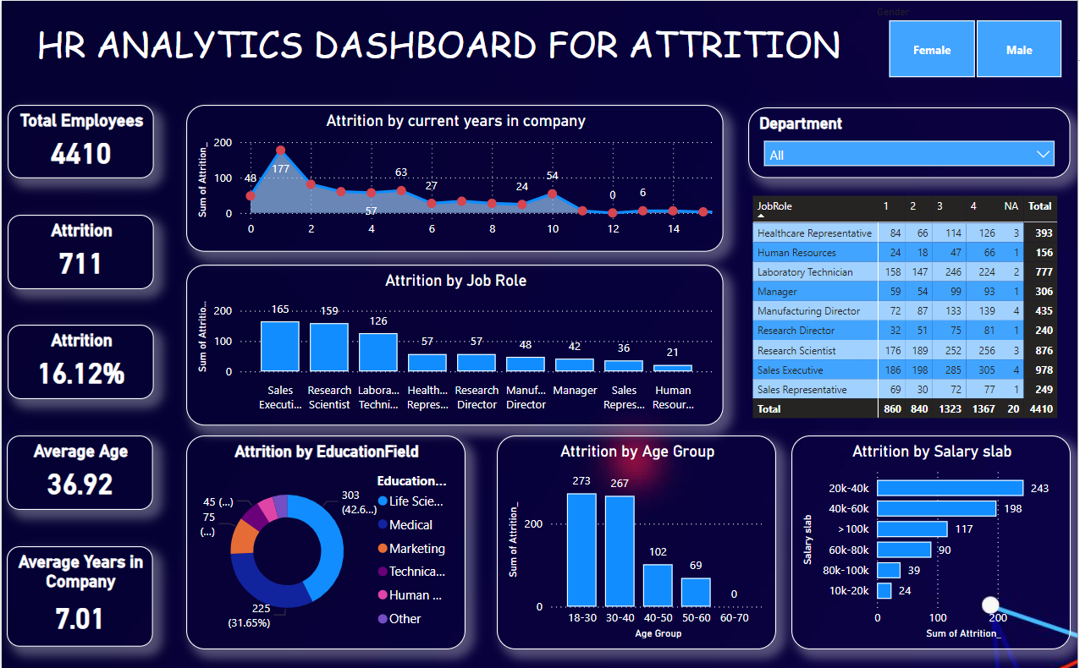
Dashboard Visual
The following visual shows the HR Analytics Dashboard created in Power BI:

Slide 4
Data Description
Dataset Source: The dataset was provided by XYZ company and contains information on employee demographics, job roles, salary, performance, and attrition status.
Key Variables:
EmployeeID: Unique identifier for each employee.
Age: Age of the employee.
Department: Department where the employee works.
JobRole: Specific job role of the employee.
Attrition: Whether the employee has left the company (Yes/No).
YearsAtCompany: Number of years the employee has been with the company.
EducationField: Field of education of the employee.
Gender: Gender of the employee.
MonthlyIncome: Monthly salary of the employee.
JobSatisfaction: Job satisfaction level (1-4).
PerformanceRating: Performance rating (1-4).
DistanceFromHome: Distance from home to work.
MaritalStatus: Marital status of the employee.
EnvironmentSatisfaction: Satisfaction with the work environment (1-4).

Slide 5
Methodology
Tools Used: Power BI for data visualization and analysis.
Steps Taken:
Data Cleaning:
Removed duplicate entries.
Handled missing values by appropriate methods (e.g., imputation, removal).
Data Transformation:
Converted categorical variables to appropriate formats.
Created new calculated columns where necessary (e.g., age groups, salary bands).
Dashboard Creation:
Designed a user-friendly and interactive dashboard using Power BI.
Included various visualizations to cover different aspects of the data.

Slide 6
Findings
Attrition Overview:
Total Employees: 4410
Attrition Count: 711
Attrition Rate: 16.12%
Demographic Insights:
Average Age: 36.92 years
Average Years in Company: 7.01 years
Highest attrition in the 18-30 age group.
Highest attrition in Life Sciences and Medical fields.
Job-Related Insights:
Sales Executives and Research Scientists have the highest attrition rates.
Higher attrition in Sales and Research departments.
Satisfaction and Performance:
Higher attrition among employees with lower job satisfaction scores.
Employees with lower performance ratings are more likely to leave.
Salary Insights:
Higher attrition in the lower salary bands (20k-40k).

Slide 7
Recommendations
Targeted Retention Programs:
Focus on high-risk groups such as young employees (18-30 age group) and specific roles like Sales Executives.
Enhanced Job Satisfaction:
Implement programs to improve job satisfaction and work-life balance.
Performance Improvement Plans: Provide support and development for employees with lower performance ratings.
Competitive Compensation:
Review and adjust salary bands for competitiveness.
Career Development Opportunities: Offer clear career progression paths and development opportunities.

Slide 8
Conclusion
The analysis provides a comprehensive view of employee attrition at XYZ company. By understanding the key factors driving attrition, the company can implement targeted strategies to reduce turnover and enhance employee retention. The interactive Power BI dashboard serves as a valuable tool for HR managers to monitor and address attrition proactively.

Slide 9
THANKS FOR WATCHING

